Slide 1

Homework #3
Eric Golde

Slide 2
Question:
Does the temperature impact how many bikers ride every day?
Did the pandemic make a difference in people riding?
What day do people ride the most?

Slide 3
Known Problems
I struggled a lot with D3, and its been a very big learning curve due to it seemingly eating issue and non working documentation.
Issues in graphs:
No axis labels
Outliers in data.
Data covers labels sometimes

Slide 4
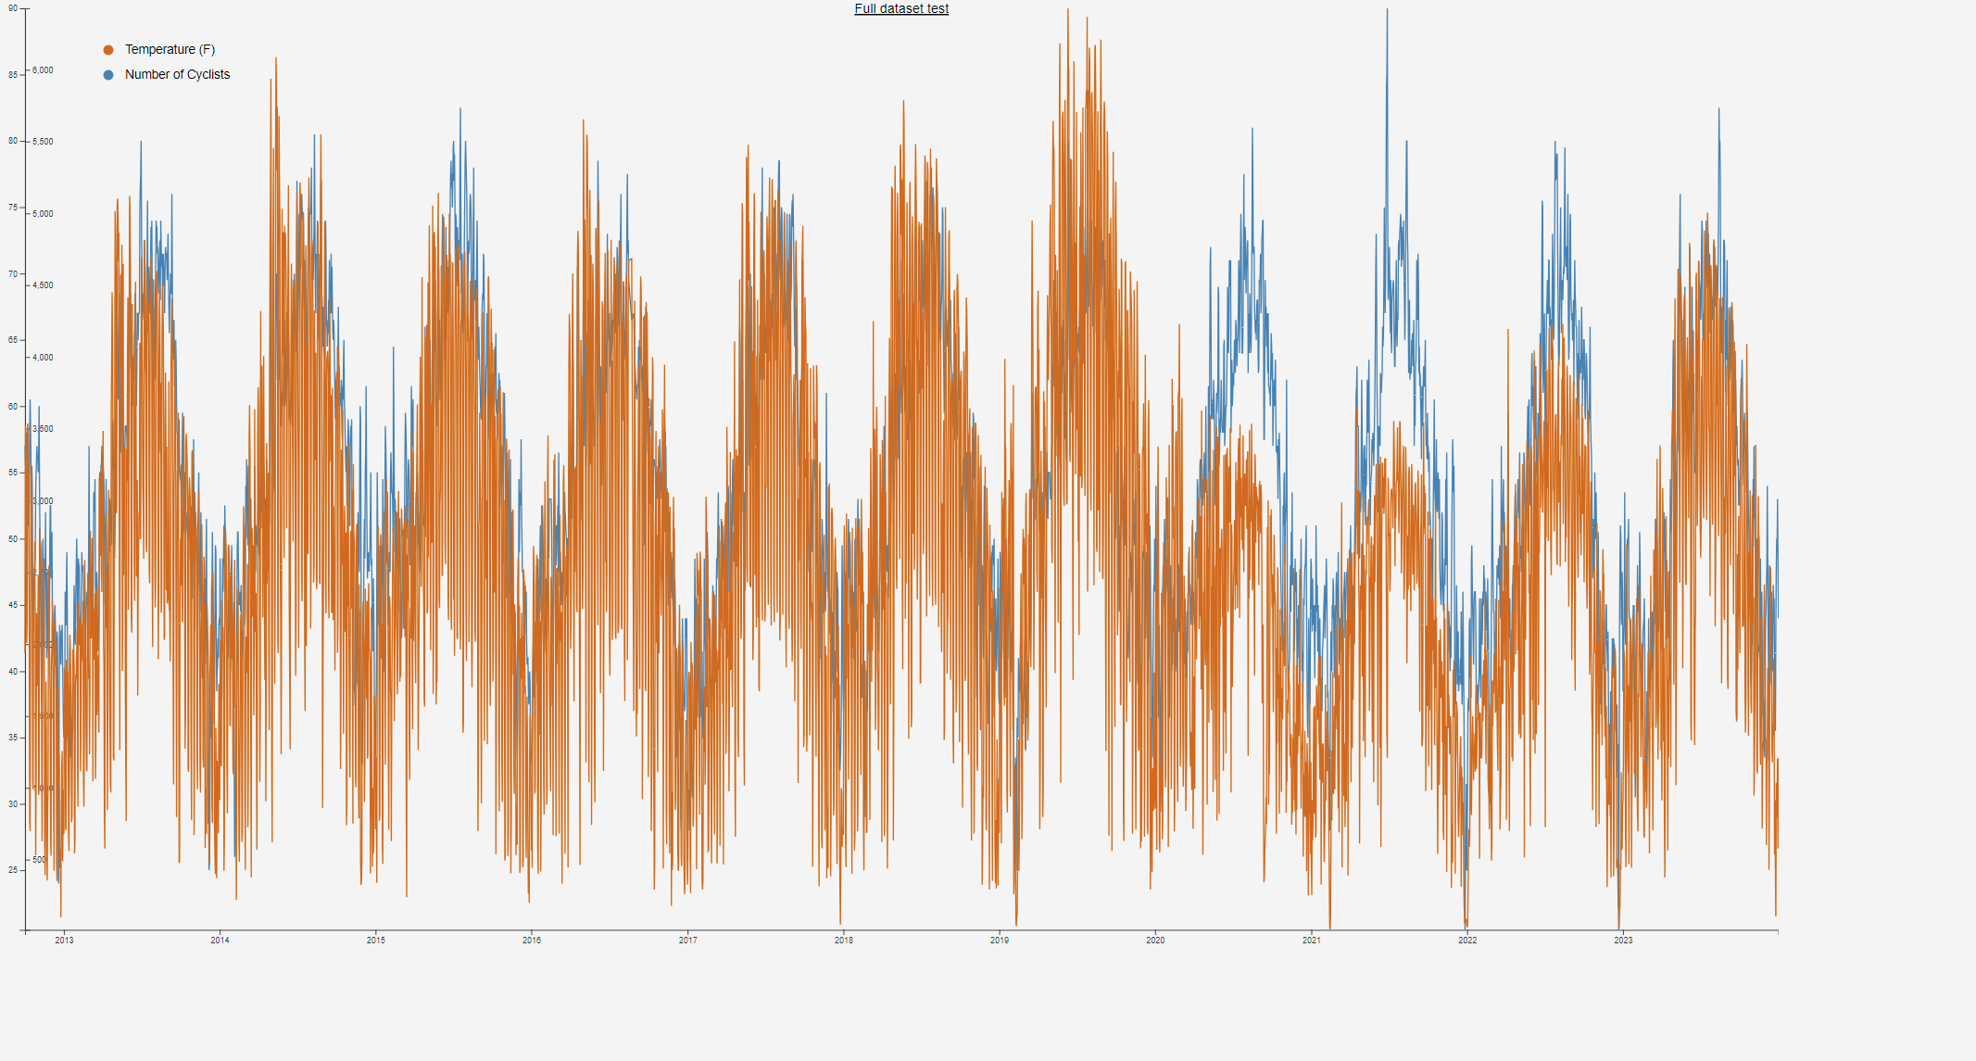
This was the first time I had ever used D3. My goal was to just get it working and to make a graph using all the data I had. It worked, but it is really very hard to read or decipher.

Slide 5
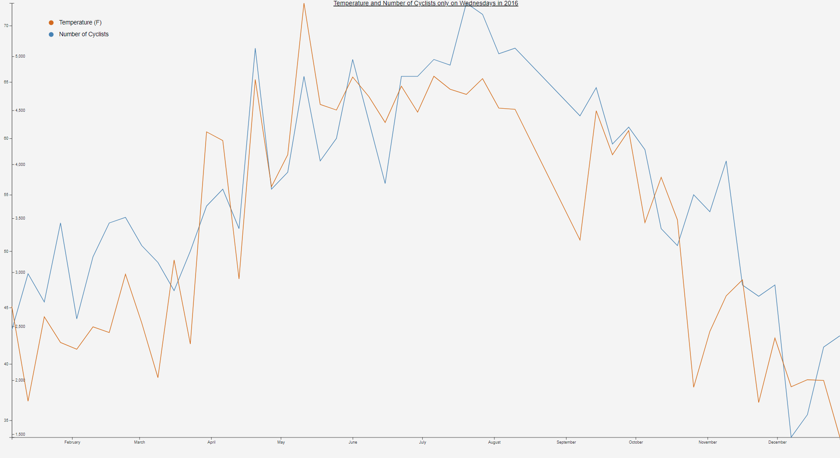
This is a much more refined version. I took the temperature and number of cyclists only every Wednesday in 2016. Here we can see there is some correlation of temperature and how many people go for a ride.

Slide 6
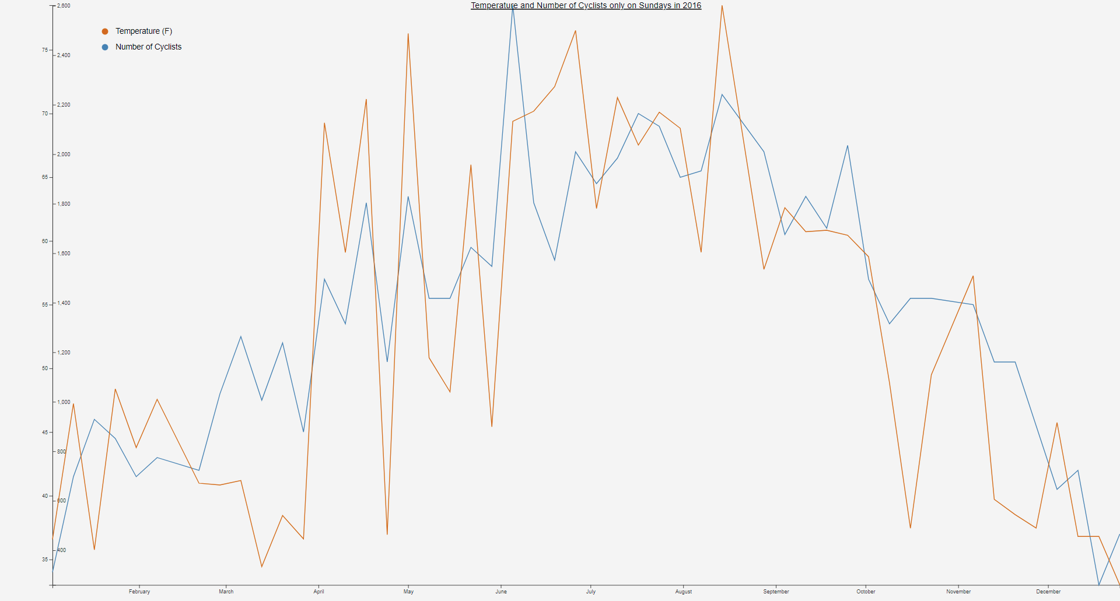
This is a much more refined version. I took the temperature and number of cyclists only every Sunday in 2016. I would say it is correlated, but maybe not as much as Wednesday.

Slide 7
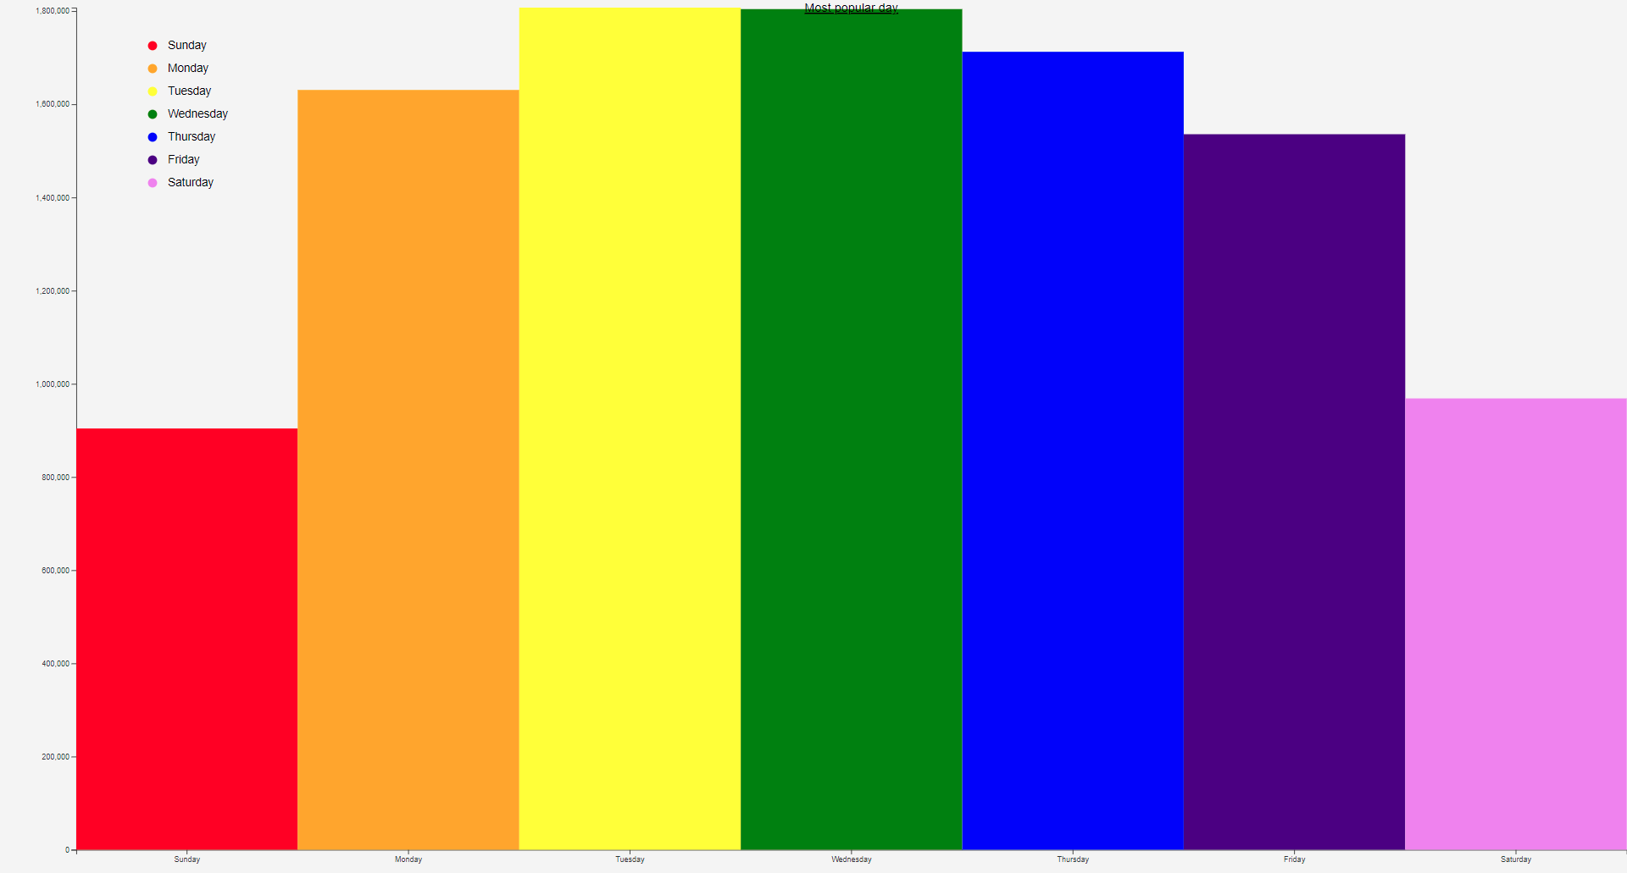
This is a bar graph of the most popular day from the entire dataset (2012-2023)

Slide 8
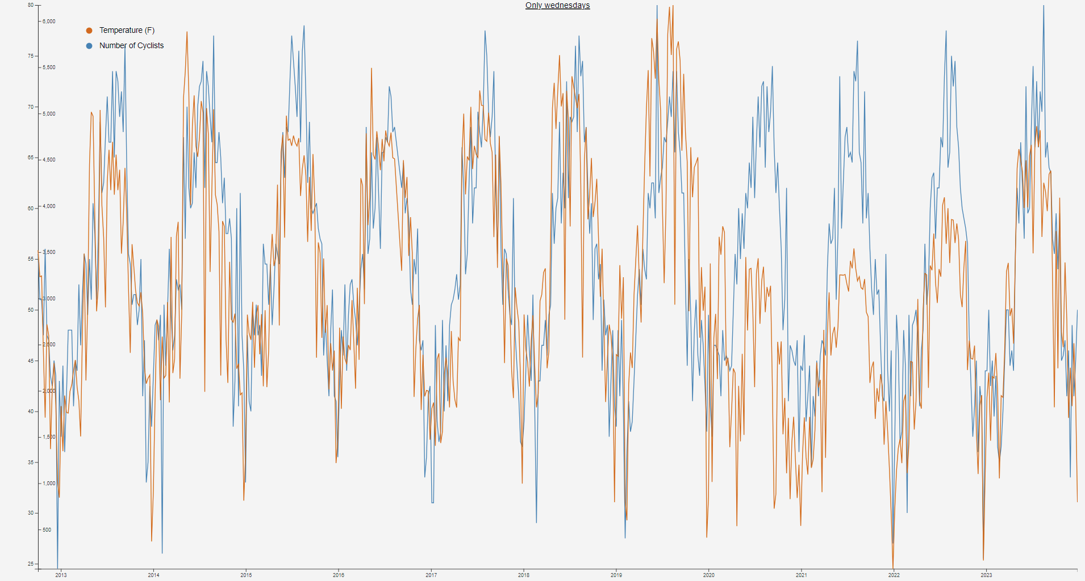
This graph is every Wednesday from 2012-2024. As you can see, I would say where is a correlation between the temperature and number of cyclists. What is interesting is you can see in 2020-2021 there is a dip of cyclists with covid.

Slide 9
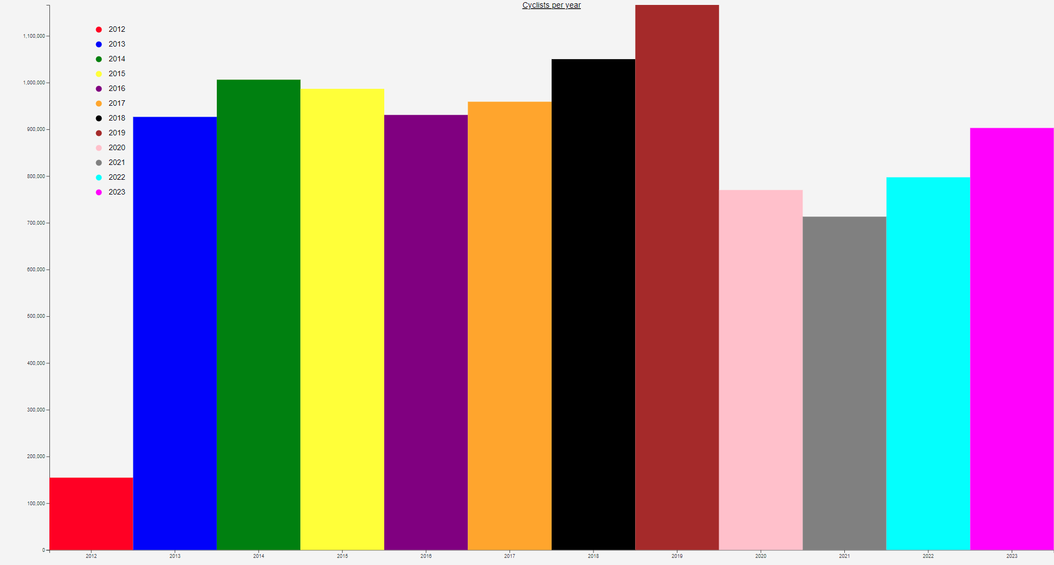
This graph shows the amount of cyclists per year. 2012 was not a full year, so it is an outlier and should be discarded when viewing this graph.

Slide 10
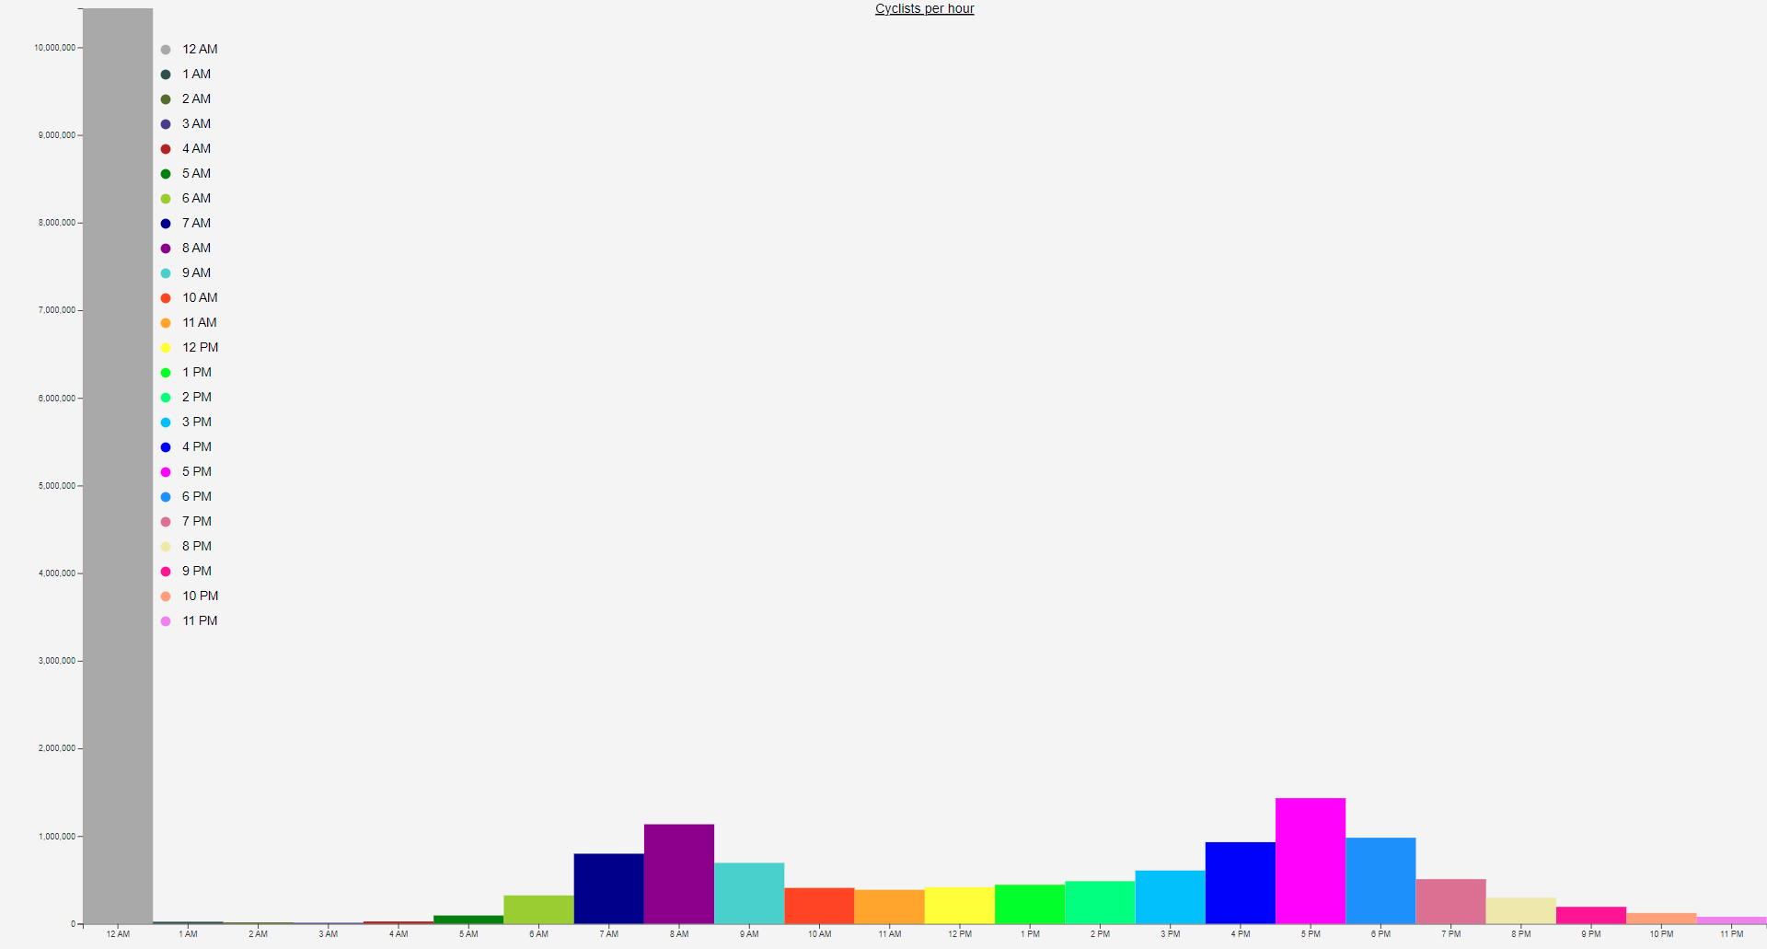
This graph is suppose to show the hours of cyclists. Unfortunately my data needs more cleaning to show this properly. If we ignore 12am, we can see that 8am and 5pm (normal business hours) are the most popular biking times.

Slide 11
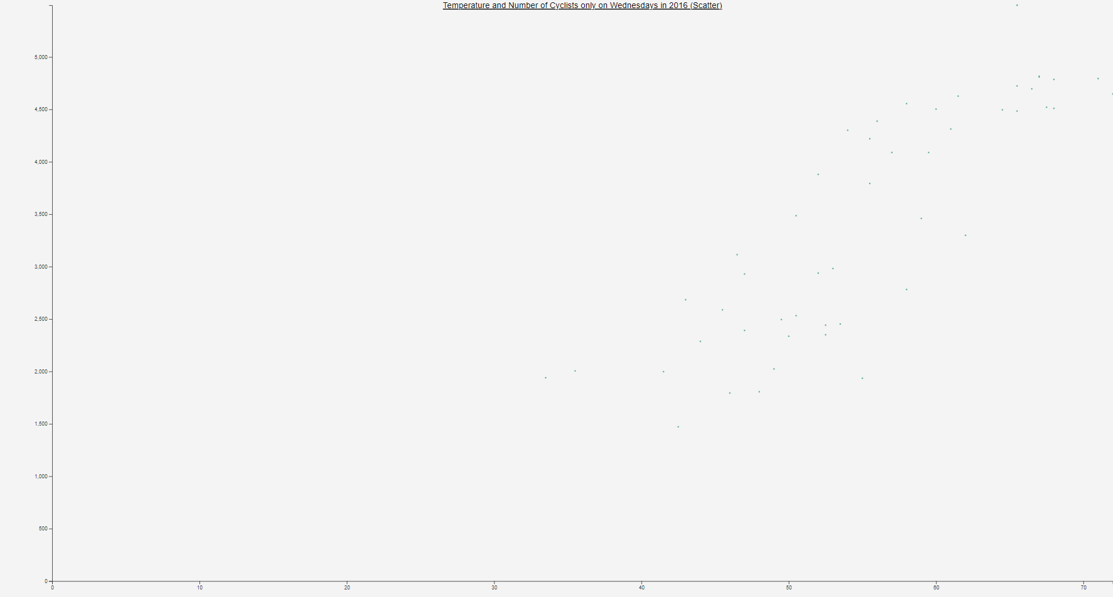
This one is Wednesdays in 2016 as a scatter plot. It’s a bit faint and hard to read.
X: Temperature, Y: Number of cyclists

Slide 12
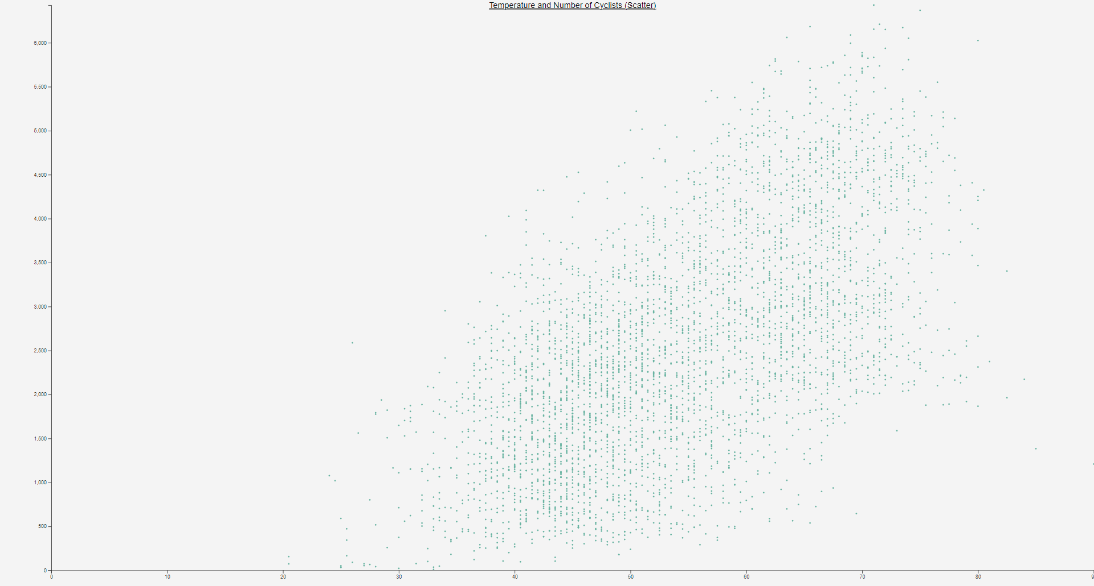
This one is all the years as a scatter plot. It is a lot more easy to read.
X: Temperature, Y: Number of cyclists

Slide 13
Summary
I struggled a lot with D3. It was a learning curve, and one small mistake can make a graph look very weird. While they do have good documentation, I found that some of the example code just did not work at all. I also did not like the lack of errors when you do something incorrect (not all d3’s fault, JavaScript isn’t great). As an example, I could not figure out how to do axis labels in D3. I spent hours trying to get it to work.
Overall, I did enjoy the project. I do though wish I had more time to work on it (Capstone is partly to blame)

